Slide 1
Enemy & NPC AI design
Designing State Machines for FUN Emergent Behaviour

Slide 2
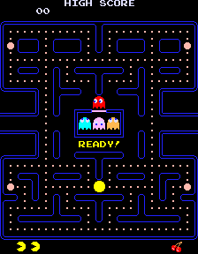
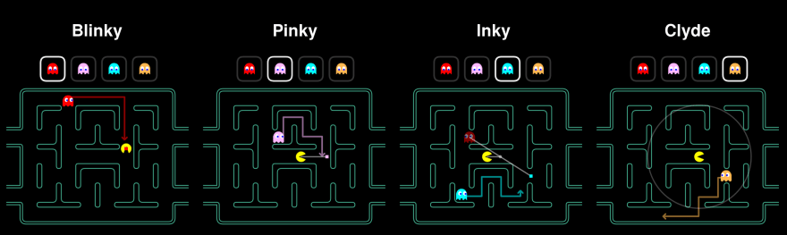
Simple Rules create complex behaviour
Different AI modes (Chase, Scatter, Frightened) and individual behaviours for each ghost
Blinky (red) chases (and gets faster when a player has collected x amount of pellets)
Pinky (pink) ambushes
Inky (blue) moves based on relative position of Blinky and player
Clyde (orange) based on distance from player. If far, will chase player. If close, will flee to bottom left
http://www.todayifoundout.com/index.php/2015/10/ghosts-pac-man-work/

Slide 3

PseudoAI Spawn point “intelligence”
https://youtu.be/BQ3iqq49Ew8?t=408
Notes:
Dead space, simple triggers that spawn enemies when player walks into them, but placed randomly, and activated randomly. Some small extra rules include not activating unless another spawnpoint is already active, allowing players to become “trapped” when they pass one trigger, spawn a monster, and back up into a previous trigger

Slide 4
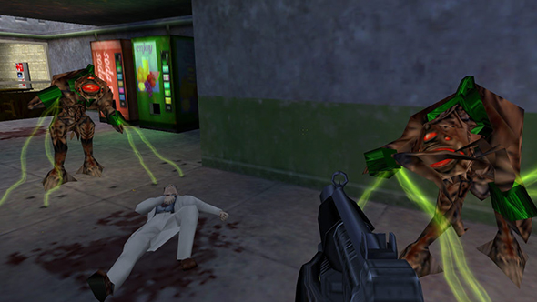
Half Life AI
One of the earliest, best examples of simple state-based AI
AI had a sense of “smell” and could “see” light
AI would change behaviour based on what it “saw” and its status
AI would work together, and would run away when low in health
https://www.youtube.com/watch?v=cOSCBMHGE18
https://www.youtube.com/watch?v=GjDY3m1SMpw

Slide 5
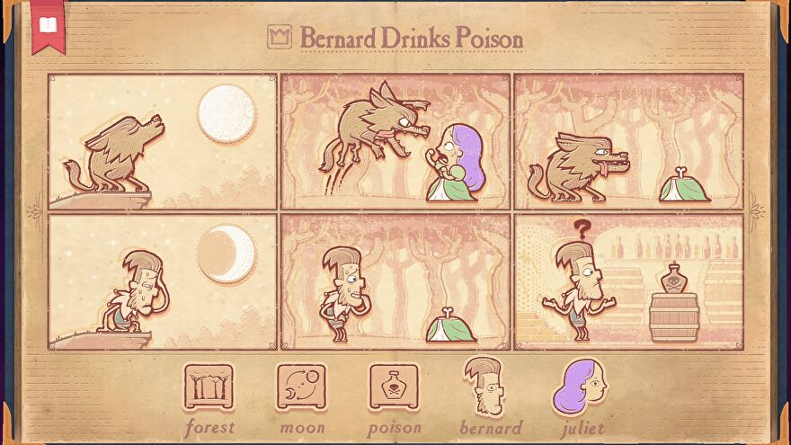
Storyteller
https://www.rockpapershotgun.com/storyteller-review

Slide 6
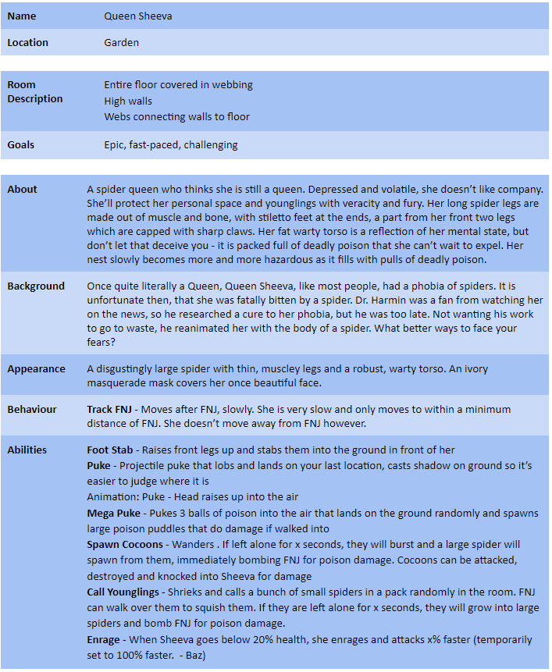
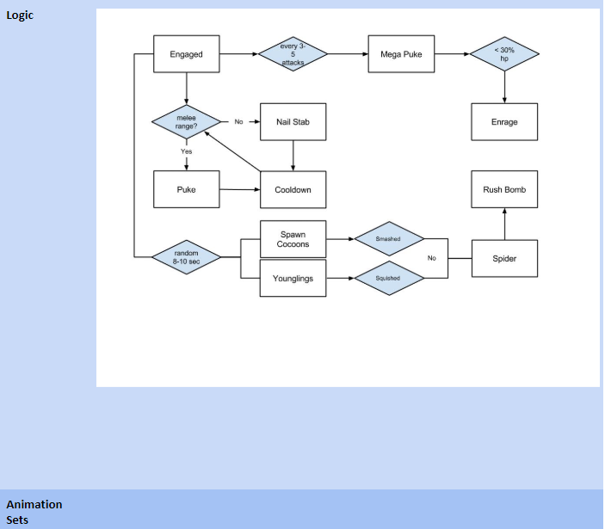
Basic Game AI: Flowchart (State based)
Set attackcount back to 0
Yes
No
Set attackcount back to 0
Add +1 to attack count
Mini Spider Spawns
Note in this design the boss can only become enraged after doing a mega puke. Thus the player has some time at 30 hp in order to try and finish the boss off before its final form
Notes:
Design an enemy that chases you when you’re alone in a house. Make it scary enough that it is terrifying, but have weaknesses so it doesn’t catch you easily

Slide 7
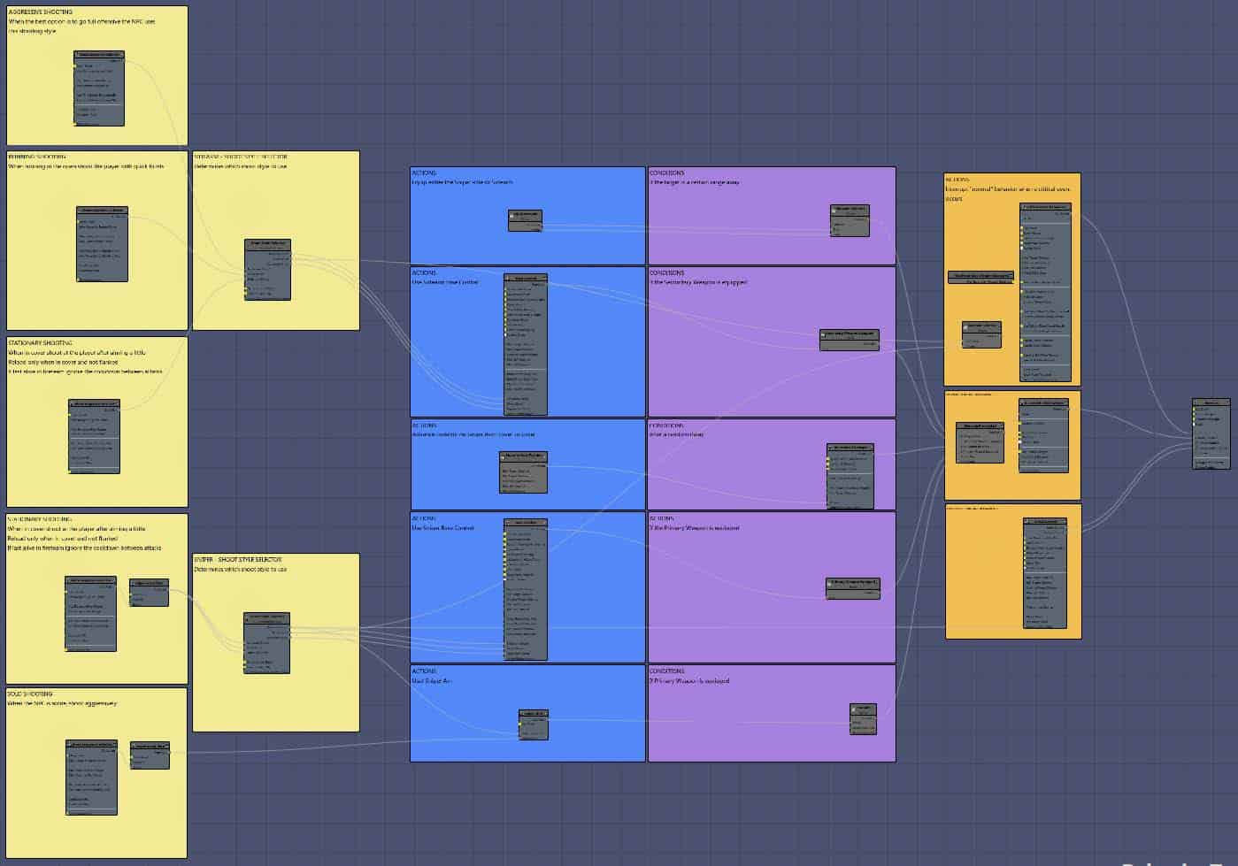
Basic Game AI: Behavior Trees (Flowcharts with multiple substates)

Slide 8
Basic Game AI – Using values for Prioritisation
Absolute values: if X happens, then Y (simple state-based)
Changing values: if X > 5, then Y (priority state based)
Allows very fluid behaviour, and overriding behaviour depending on values
E.g. Fear stat: increased when health is lower, when enemy sees other dead enemies, when player has higher level weaponry, when light is not detected
Will run if fear is above X
If player health is below Y, X is increased (what does this mean in a gameplay context?)

Slide 9
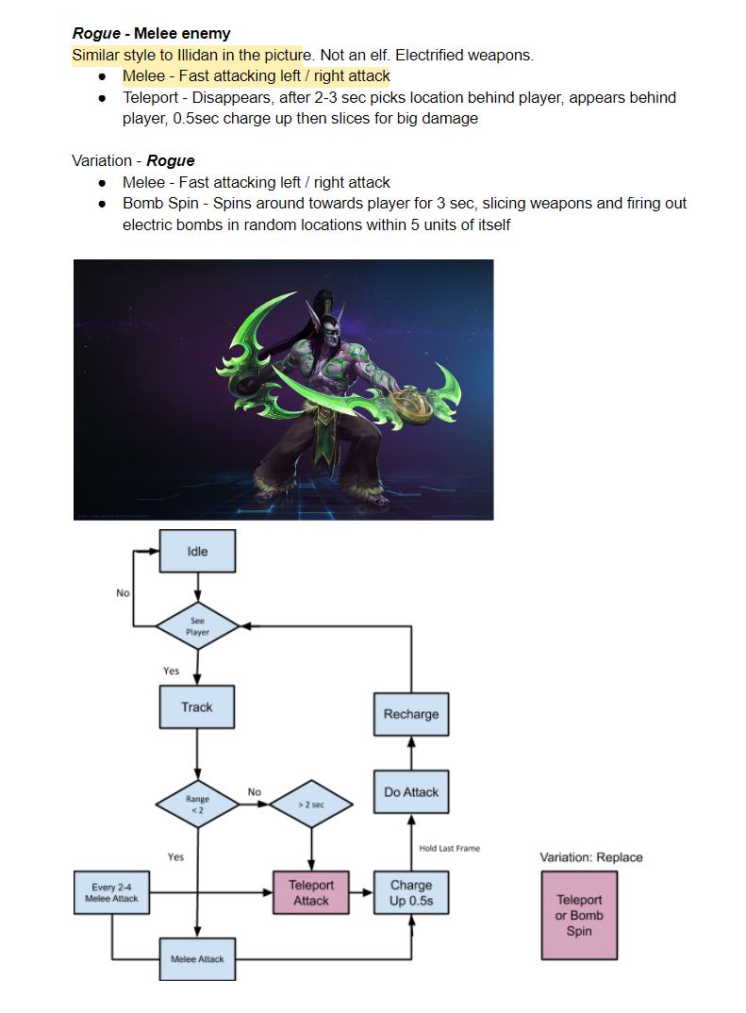
(Pseudocode) Design intended behaviour first, add numbers later
Use flowcharts to design/decide what you want the enemy to do, THEN create scripts and assign stats that fit your desired behaviour

Slide 10
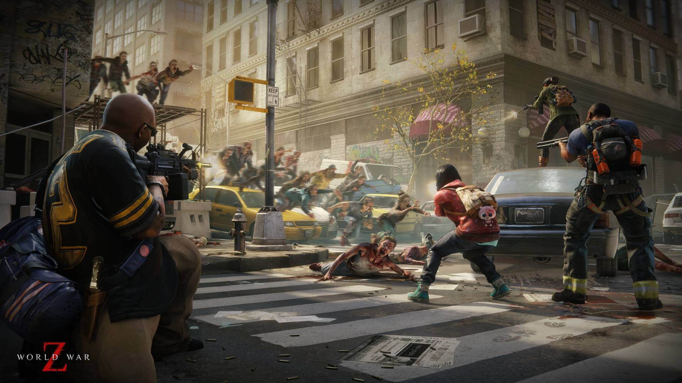
Constrain AI – Skill Constraints
AI can be “perfect”
Perfect aim, perfect attack, no cooldowns, no speed pauses in attack – these are all bad
This would not only be overwhelming, it means there is no “skill” component to deal with the AI
Notes:
Often new developers create these kinds of AI and tell the player to git gud. It isn’t possible to git gud, and even if it was, there is no outsmarting, assessing or even muscle memory to learn to defeat the AI

Slide 11
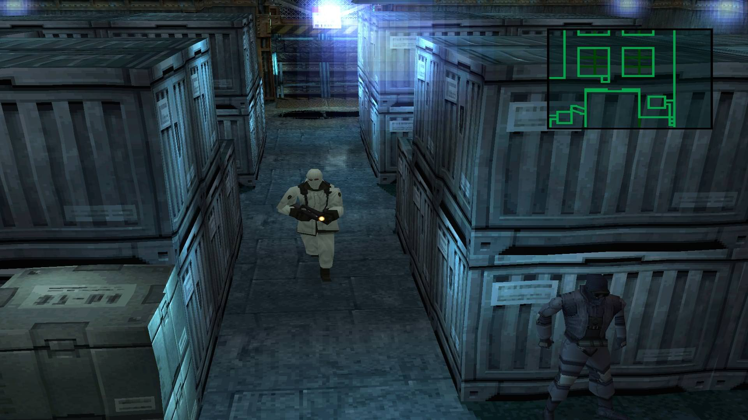
Location Constraints
Communication Sphere (can only communicate to nearby enemies)
Patrol “tether” (cannot run too far away from bounding point, unless direct LOS to player)
Physical barriers (limited FOV, and confounded by more barriers than player)

Slide 12
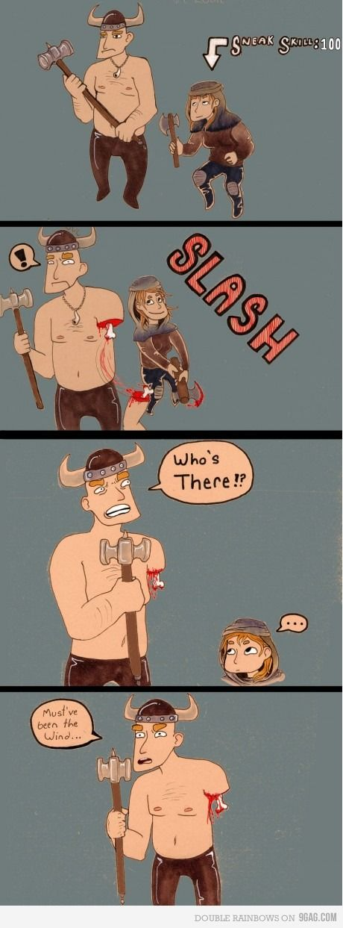
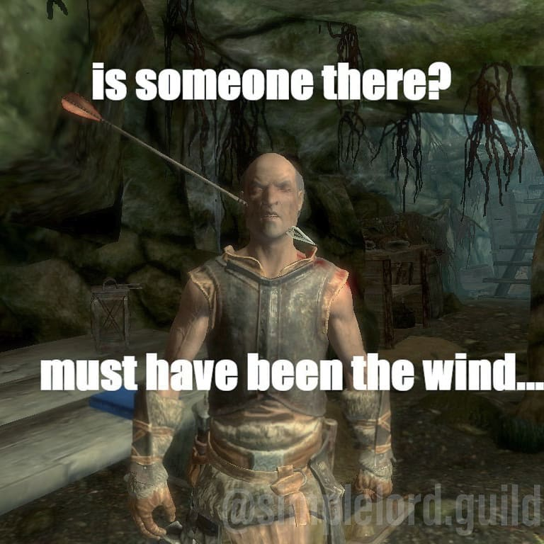
Temporal Constraints
Enemies have a quick “forgiveness” timer
Longer timer in stealth games such as Metal Gear – still quick to go from “High Alert” to “Caution”

Slide 13

Ability Constraints – AI must have EXPLOITABLE weaknesses
Bioshock/Uncharted – first shot always misses
Sphere/circle of attack that enemies aim for
Low-speed projectiles
Weak Spots, slow movement/aim

Slide 14
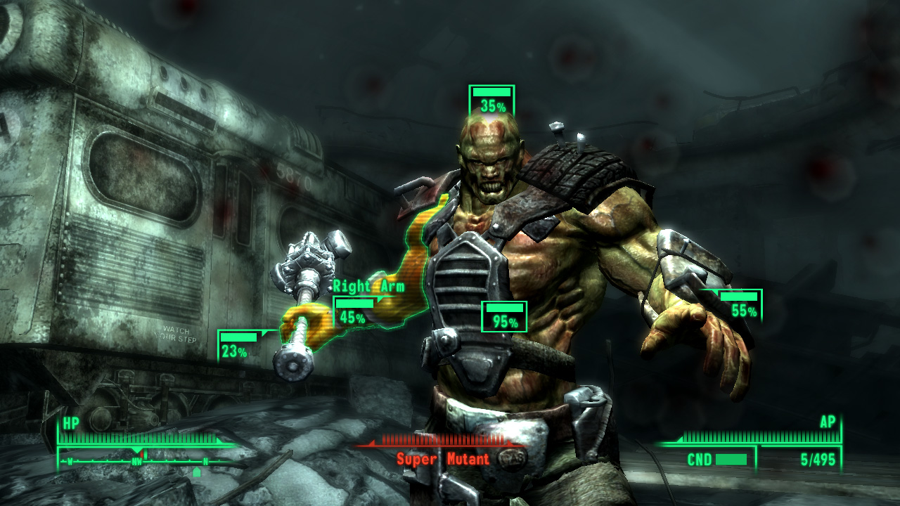
Weight probability in player’s favour
Often, even if an odd is calculated at 50% to miss, the game is secretly doing a second calculation
If the last shot had already missed, the 50% might be secretly increased to 70%
A 95% player hit chance is often rounded to 100%. A 95% enemy hit chance is often dropped to 75%
Similarly, AI will be more likely to perform weaker attacks/displacement attacks or miss after a successful high dmg attack

Slide 15
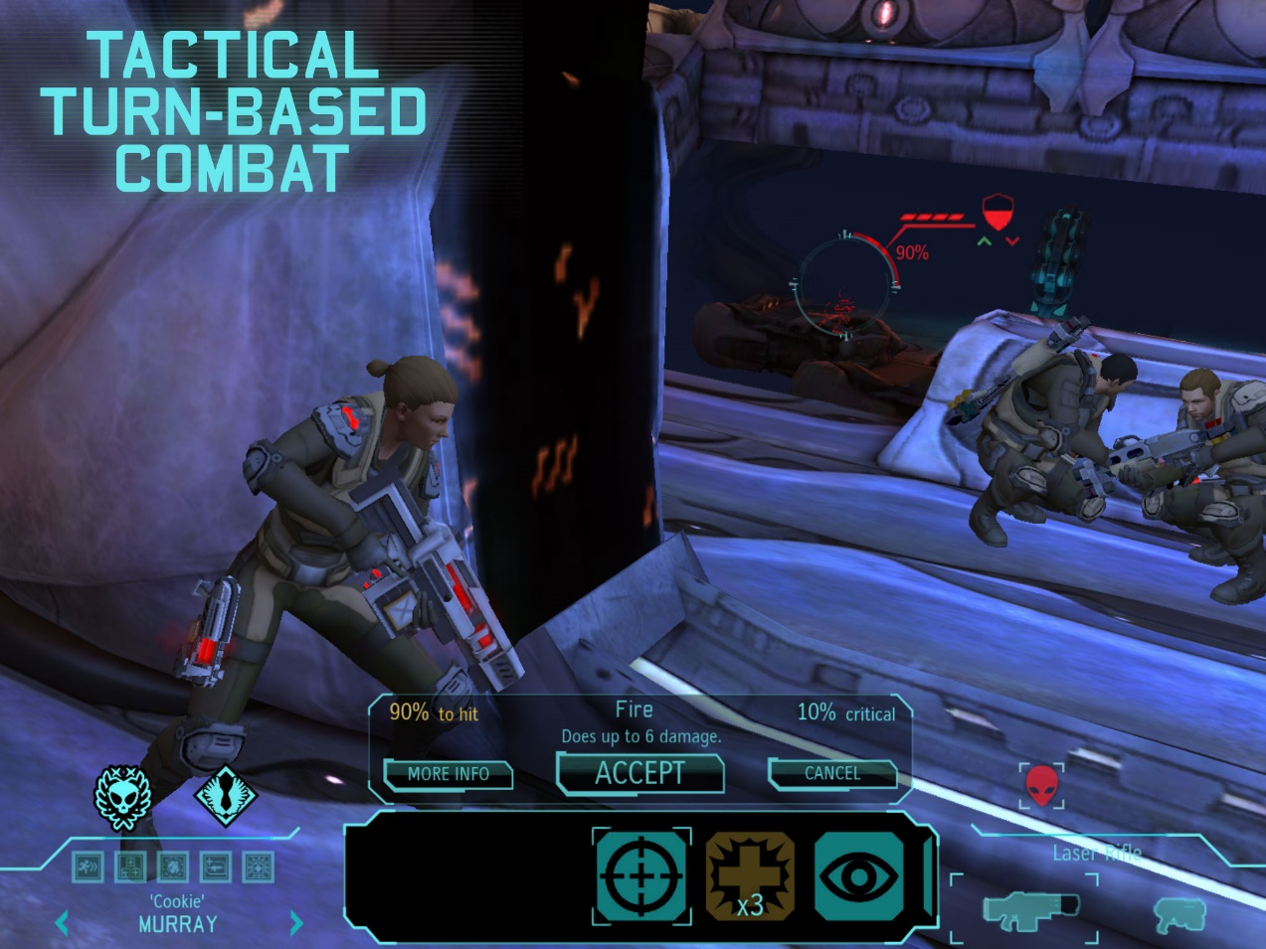
Probability to create Tension
Player chances often rise even more with worse performance/AI performs worse
E.g. lower health players have their hit targets expanded, so it feels like they’re dodging more bullets
Crit probability rises when player/boss health is lower for that “unbelievable luck” story
https://www.youtube.com/watch?v=sLXLlJ7FhJU&sns=tw

Slide 16
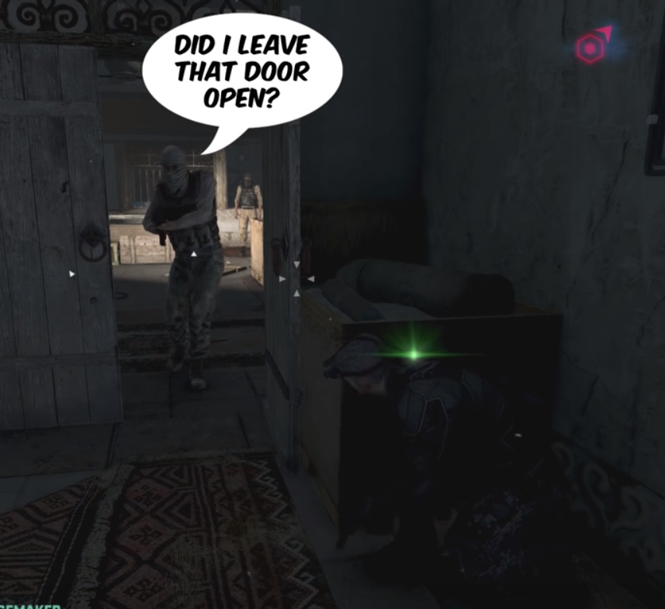
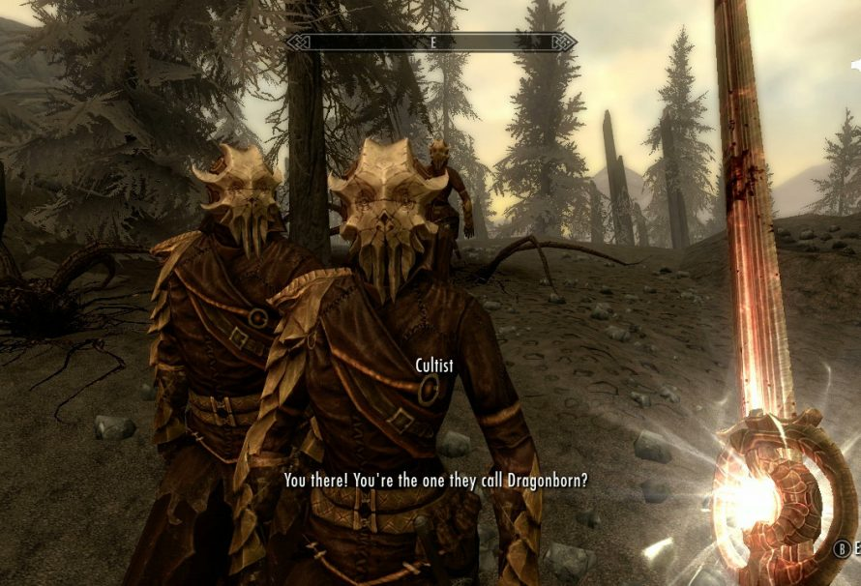
Acknowledge Player Actions (Context-Dependent)
Warns player what AI is paying attention to
Immersion – actions impact Game World
Can also be storytelling; “Aren’t you the Dragonborn?” “Wow it’s XYZSlayer2000xx that defeated the great Cthulhu”

Slide 17
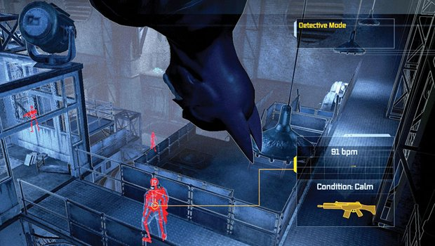
Context-Dependent Behavioural Probability (remember using values to drive behaviour)
In Arkham Asylum, during Predator challenges, the likelihood of enemies to turn around is reduced, allowing players to sneak up behind enemies more.

Slide 18
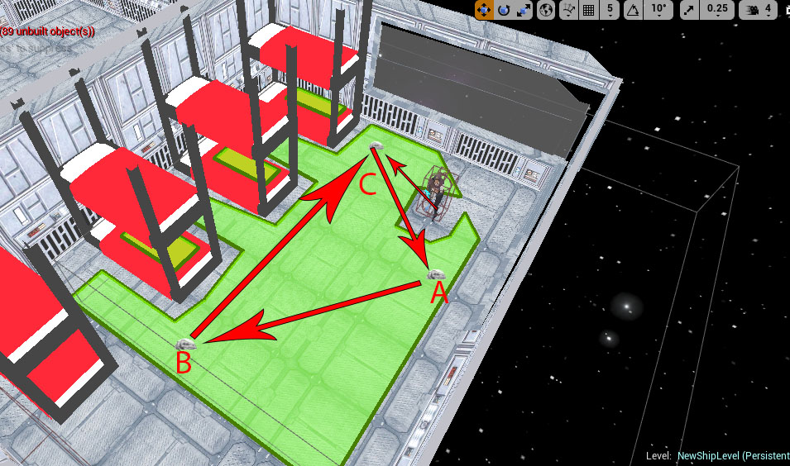
Predictability
Easy to learn patterns of movement and even attacks
High repeatability so players can learn and can devise solution
Large gaps in patrol routes – stopping at windows, in low-visibility areas. Pausing for a few seconds before resuming patrol

Slide 19
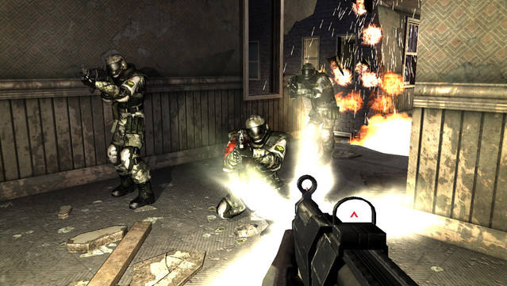
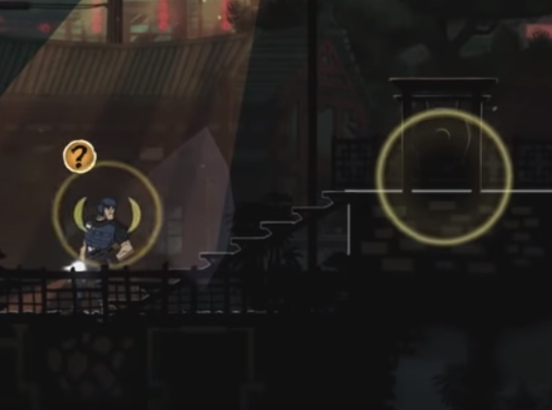
Broadcast Intentions
FEAR AI would bark commands loudly for the benefit of players, and would even wait for lulls in shots to bark commands
Mark of the Ninja – animations, effects AND UI Markers to let players know enemy intention and status

Slide 20
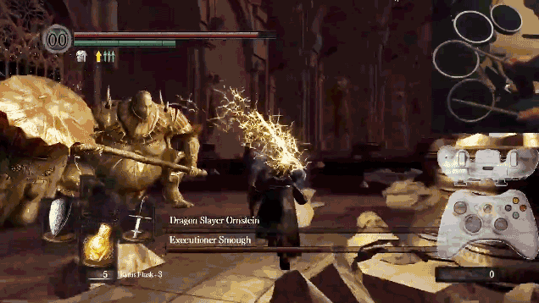
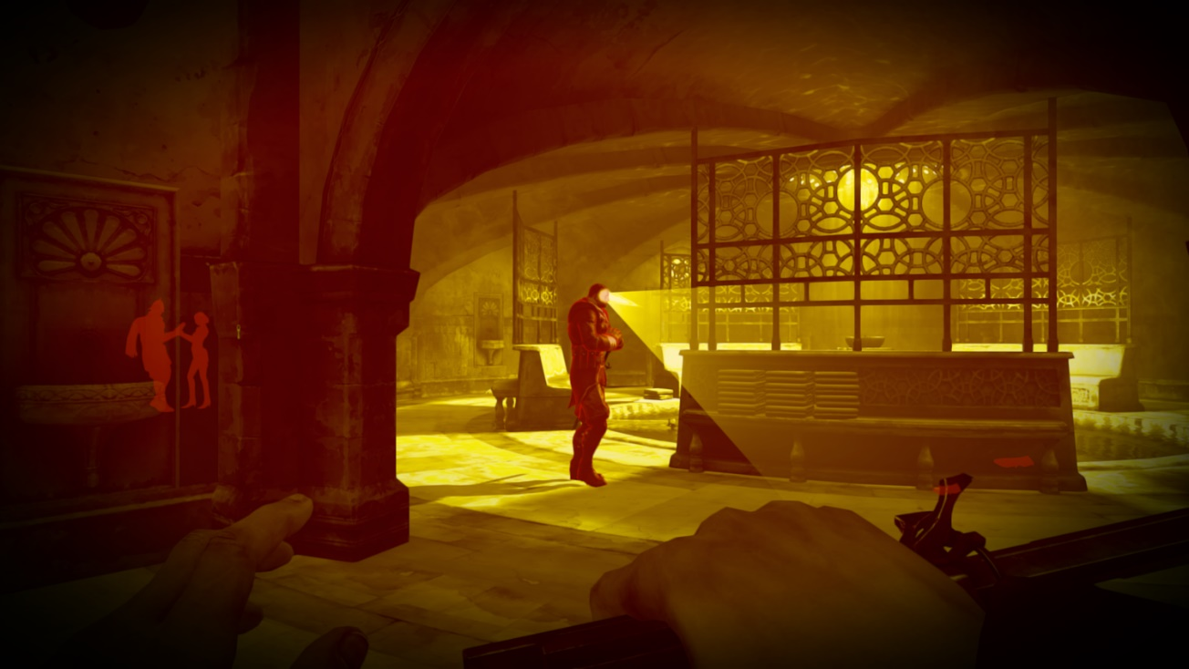
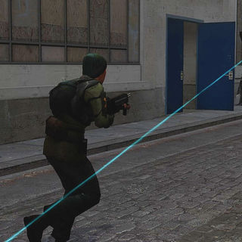
Broadcast Intentions: Telegraphs
Attack Windups
Attack Cooldowns
Positional aids, ability to see where enemy is looking

Slide 21
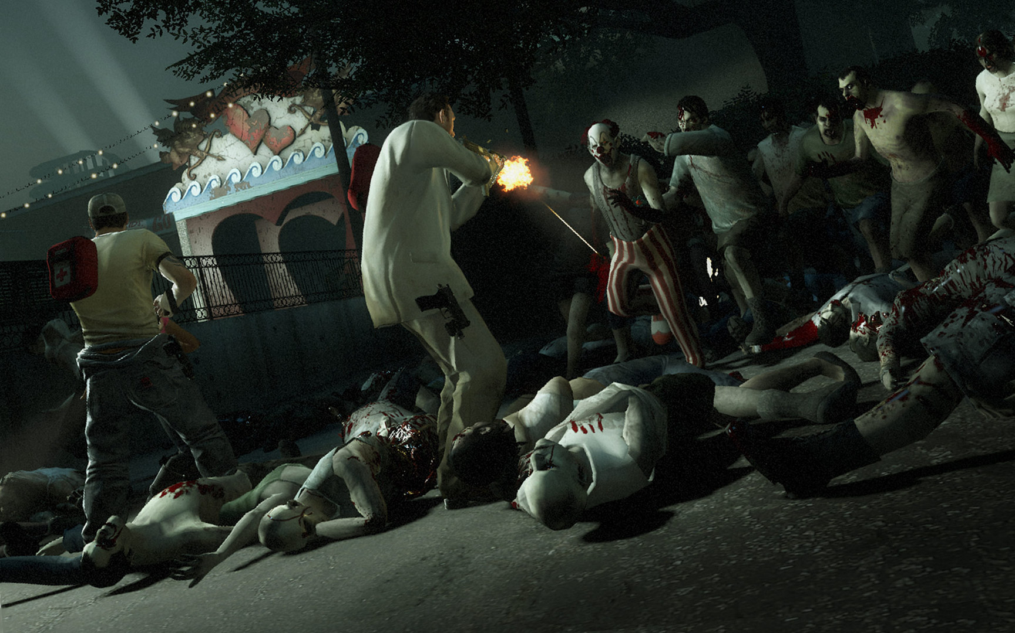
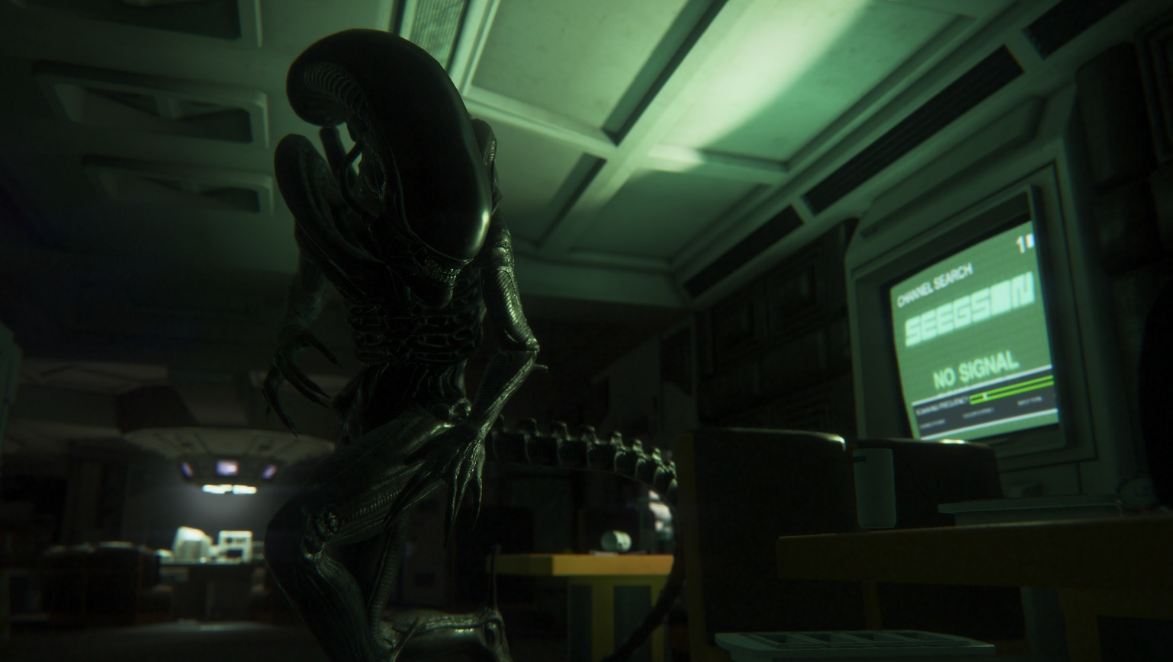
Hide Overarching Logic
In both these games, the physical enemy(s) reveal themselves, their intentions and their attacks through sound cues
The game’s Directors/overall logic is completely hidden to the player
https://kotaku.com/how-the-alien-in-alien-isolation-works-1585594283
https://www.gamasutra.com/blogs/TommyThompson/20171031/308027/The_Perfect_Organism_The_AI_of_Alien_Isolation.php
Notes:
L4D2 – raises or lowers difficulty based on player’s proximity to an exit, and raises and lowers this tension throughout the game.
Alien Isolation AI: If Alien doesn’t know where you are, it will go into vents and try to detect you using noise/smell. If you get too far ahead, Director AI will prioritise areas ahead of you, so Alien can try to catch you. The Director also has a menace gauge that tells it how “stressful” it is making the game
Whether the creature is within a short walking distance of the player.
Whether the player has actual line of sight on the alien.
Whether the alien was close on the motion tracker, but could also reach the player quickly.
Also, if the alien has been near you for awhile and you are hiding well, the Director AI sends the Alien away to give you a breather

Slide 22
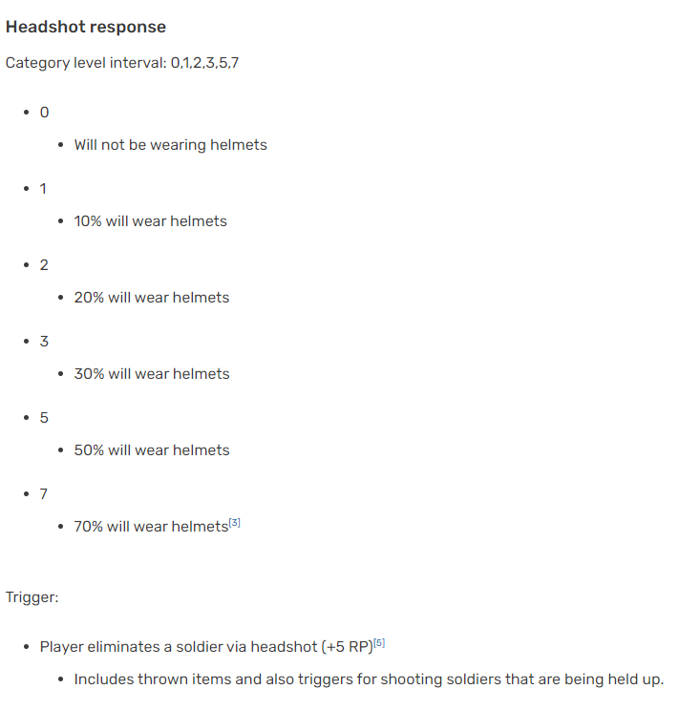

https://metalgear.fandom.com/wiki/Revenge_System_(enemy_preparedness)

Slide 23
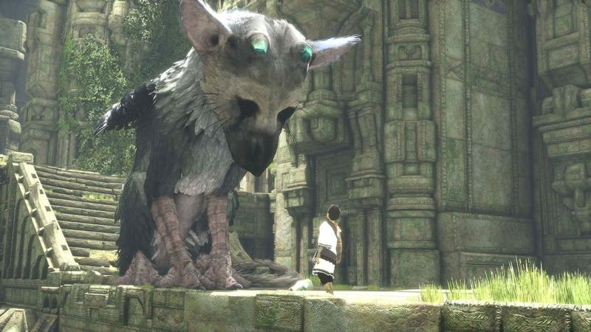

Friendly AI
Last Guardian – in order to make players feel like they are taming, there is a randomised “response” to orders. Over time, Trico is much more likely to respond quickly (if treated well)
Bioshock Infinite – Elizabeth is designed to never block doorways, and to provide aid contextually (player is low on health/ammo, about to fight a big boss, has been searching everything in the room)
https://www.gamesradar.com/the-last-guardians-trico-is-the-gamings-perfect-pet-and-a-truly-smart-piece-of-design/
https://venturebeat.com/community/2013/04/05/smoke-mirrors-how-bioshock-infinite-tricks-you-into-liking-elizabeth/

Slide 24
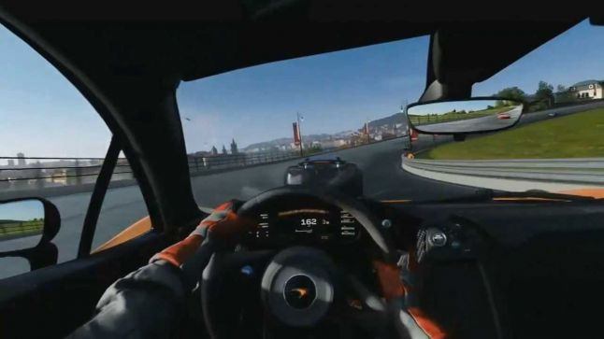
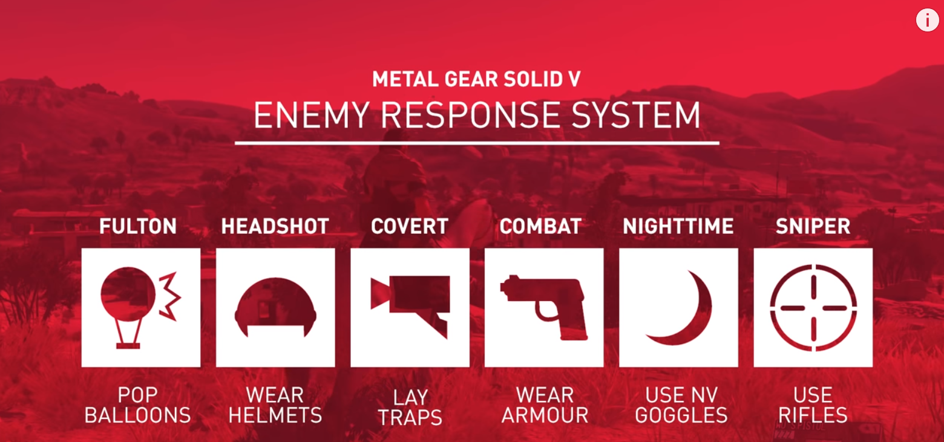
AI Learning, and even DEVELOPING Games
Forza Drivatar emulates player movements/driving around tracks
MGS Phantom Pain enemy NPC change equipment loadouts and behaviour
https://medium.com/aifrontiers/an-overview-of-artificial-intelligence-for-video-games-f491229c0e7d
https://www.theverge.com/2019/3/6/18222203/video-game-ai-future-procedural-generation-deep-learning

Slide 26
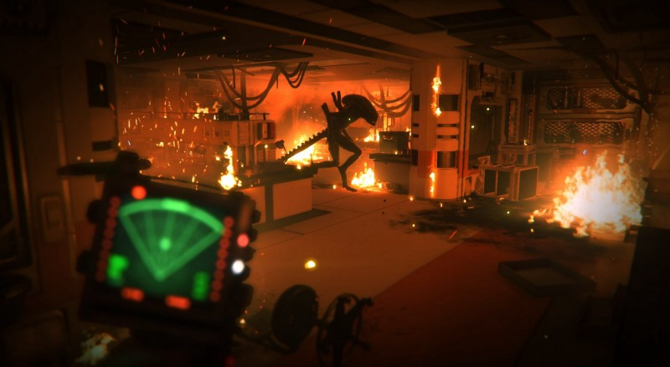
Pseudo-Learning
Alien Isolation: Alien unlocks new behaviours as time goes on.
Seems to be “learning” based on events in the game
None of the learning come from player death events – too unfair and hard for the player to learn from this

Slide 27
“The goal is not to create something that is unpredictable. What you want is an artificial intelligence that is so consistent that the player can give it certain inputs. The player can do things and expect the AI to react in a certain way.”
Chris Butcher, Bungie
(Halo: Combat Evolved AI programmer)

Slide 28
Extra Reading
https://software.intel.com/en-us/articles/designing-artificial-intelligence-for-games-part-1
https://www.gamasutra.com/view/news/269634/7_examples_of_game_AI_that_every_developer_should_study.php
http://www.gamasutra.com/blogs/TommyThompson/20181203/331725/Enemy_AI_Design_in_Tom_Clancys_The_Division.php
https://www.youtube.com/watch?v=QUjtDdKM6oc – How to Create AI for Strategy Games
https://www.youtube.com/watch?v=9bbhJi0NBkk – Game Maker’s Toolkit what makes good Game AI
https://www.youtube.com/watch?v=1xWg54mdQos – Less is More, Designing Awesome AI for Games (GDC Vault Talk)
https://towardsdatascience.com/how-to-teach-an-ai-to-play-games-deep-reinforcement-learning-28f9b920440a

Slide 29
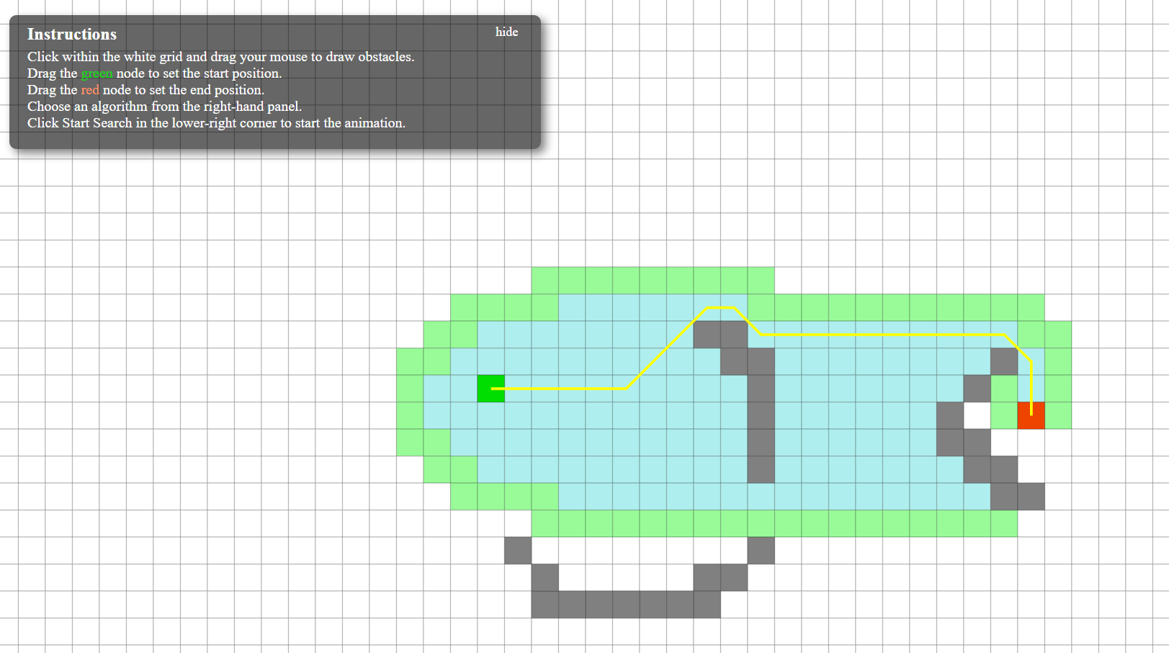
Extra Reading
AI Disasters: https://www.youtube.com/watch?v=__5whYgSTV0
Pathfinding, visualised: https://qiao.github.io/PathFinding.js/visual/

Slide 30
Encounter Design Exercise – 3 player hack N slash
Design 3 entities that a team of 3 players (Heal, Tank, Warrior or your choice of class) might encounter upon coming across an enemy outpost
Build in special states for each entity (e.g. runs away when at 10% health)
With each entity, list the desired “experience” the player should have
Bonus points for interactions between entity types
Notes:
From last year’s students

Slide 32
Interaction Flowcharts Exercise
Design 3 entities that will stalk a player, who is trying to escape a hallway
Build in special states for each entity
The player cannot kill the entities, only “stun” them
Notes:
From last year’s students

Slide 33
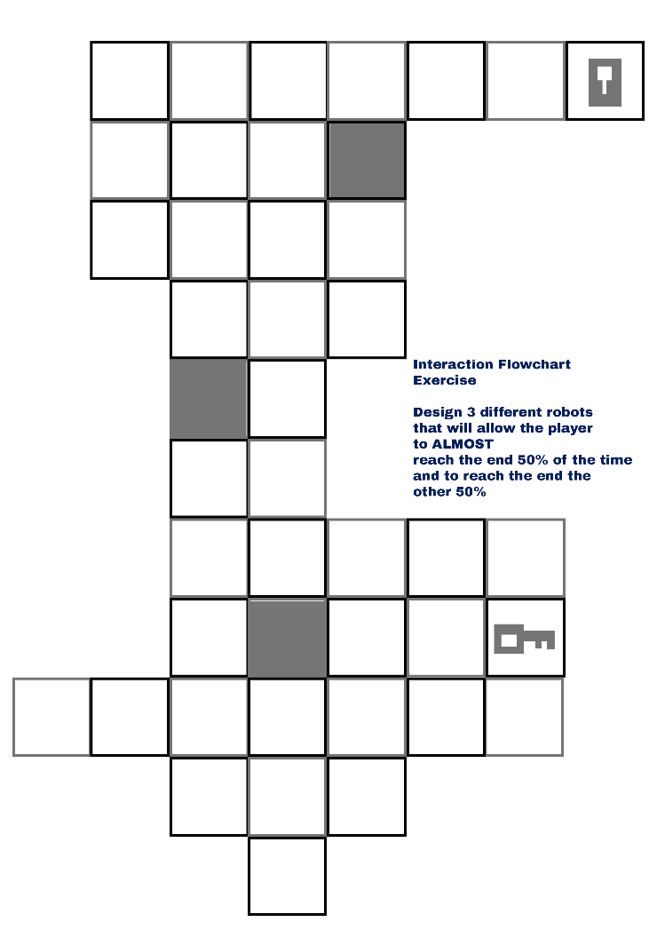
If a modifier is needed, use a D6
Player moves UP TO 4 places at once
Entities should be preprogrammed with “idle” patrol states. Their field of view is only in a STRAIGHT LINE – up to you how far
Place the player and entities wherever you wish
Design the 3 entities so that the player will reach the end 50% of the time, and be caught the other 50%
The darker squares are for you to add design rules as you wish
Notes:
Also note – if it’s too easy, you can create separate states for when the key is taken, e.g. entities become enraged etc

